Slide 1

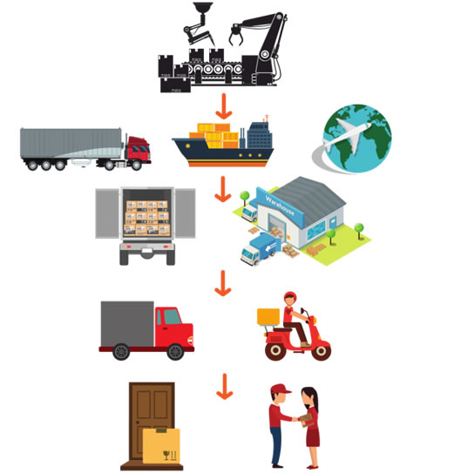
Asia DataCo Chain Management Dataset
Supply chain management plays a crucial role in the success of businesses, ensuring that products are delivered to customers in a timely and efficient manner.
Sahil Rustagi
Presented By

Slide 2

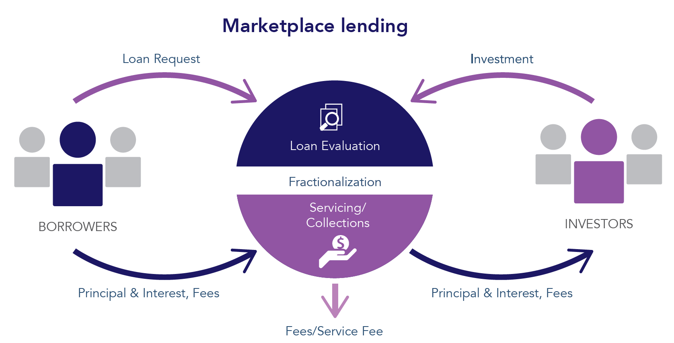
About Dataset

Slide 3

01
Problem Statement
Develop a machine learning classification model that predicts whether a given order or shipment is at risk of being delivered late or on time.
Late Delivery
On-Time Delivery
1
0

Slide 4
Description
INDEPENDENT VARIABLES DESCRIPTION Type: Type of transaction made Days for shipping (real): Actual shipping days of the purchased product Days for shipment (scheduled): Days of scheduled delivery of the purchased product Benefit per order: Earnings per order placed Sales per customer: Total sales per customer made per customer Delivery Status: Delivery status of orders: Advance shipping , Late delivery , Shipping canceled , Shipping on time Category Id: Product category code Category Name: Description of the product category Customer City: City where the customer made the purchase Customer Country: Country where the customer made the purchase Customer Email: Customer's email Customer Fname: Customer name Customer Id: Customer ID Customer Lname: Customer lastname Customer Password: Masked customer key Customer Segment: Types of Customers: Consumer , Corporate , Home Office Customer State: State to which the store where the purchase is registered belongs Customer Street: Street to which the store where the purchase is registered belongs

Slide 5
Customer Zipcode: Customer Zipcode Department Id: Department code of store Department Name: Department name of store Latitude: Latitude corresponding to location of store Longitude: Longitude corresponding to location of store Order City: Destination city of the order Order Country: Destination country of the order Order Customer Id: Customer order code order date (DateOrders): Date on which the order is made Order Id: Order code Order Item Cardprod Id: Product code generated through the RFID reader Order Item Discount: Order item discount value Order Item Discount Rate: Order item discount percentage Order Item Id: Order item code Order Item Product Price: Price of products without discount Order Item Profit Ratio: Order Item Profit Ratio Order Item Quantity: Number of products per order Sales: Value in sales Order Item Total: Total amount per order Order Profit Per Order: Order Profit Per Order Order Region: Region of the world where the order is delivered: Southeast Asia , South Asia ,Oceania ,Eastern Asia, West Asia , West of USA , US Center , West Africa, Central Africa ,North Africa ,Western Europe ,Northern , Caribbean , South America ,East Africa ,Southern Europe , East of USA , Canada , Southern Africa , Central Asia , Europe , Central America, Eastern Europe , South of USA Order State: State of the region where the order is delivered Order Status: Order Status: COMPLETE, PENDING, CLOSED, PENDING_PAYMENT, CANCELED, PROCESSING,SUSPECTED_FRAUD, ON_HOLD, PAYMENT_REVIEW

Slide 6
Product Card Id: Product code Product Category Id: Product category code Product Description: Product Description Product Image: Link of visit and purchase of the product Product Name: Product Name Product Price: Product Price Product Status: Status of the product stock :If it is 1 not available , 0 the product is available Shipping date (DateOrders): Exact date and time of shipment Shipping Mode: The following shipping modes are presented: Standard Class , First Class , Second Class , Same Day DEPENDENT VARIABLES DESCRIPTION Late_delivery_risk: Categorical variable that indicates if sending is late (1), it is not late (0).

Slide 7

Phase -1 EDA with Base Model
Group 2
Presented By

Slide 8
02
Exploratory Data Analysis
Phase
01
Phase
02
Phase
03
Phase
04
Phase
05
Univariate followed by
Bivariate Analysis
Data Pre- Processing
(Scaling & Encoding)
Column Selection
Treating
Missing Values
Statistical Analysis

Slide 9
Column Selection
P
H
A
S
E
1
01
We have selected only the individual columns that show the necessary impact on the target column, so we have removed all the unnecessary columns.
02
We removed all the columns with unique values, such as customer id, captcha id, id, product id, etc.
03
We removed the data with more than 97.5% of the null value.
04
Selecting only variables known at the moment for predicting the late and on time delivery risk and excluding all other variables. Eg, product category id, status and image not been taken into consideration since the purpose of it is to predict whether a given order or shipment is at risk of being delivered late or on time.

Slide 10
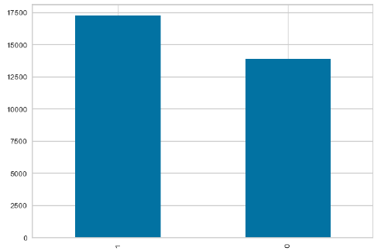
Univariate followed by Bivariate Analysis
P
H
A
S
E
2
Target Variable
17230
Total no. of Samples =31112
13882

Slide 11
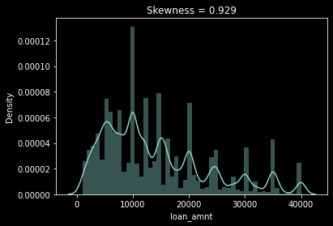
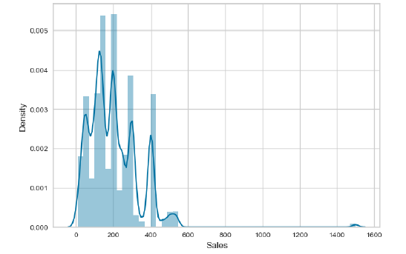
Sales as per the visual analysis, we can say that the Sales column is following a good visual trend and can be a good predictor.
Univariate followed by Bivariate Analysis
P
H
A
S
E
2

Slide 12
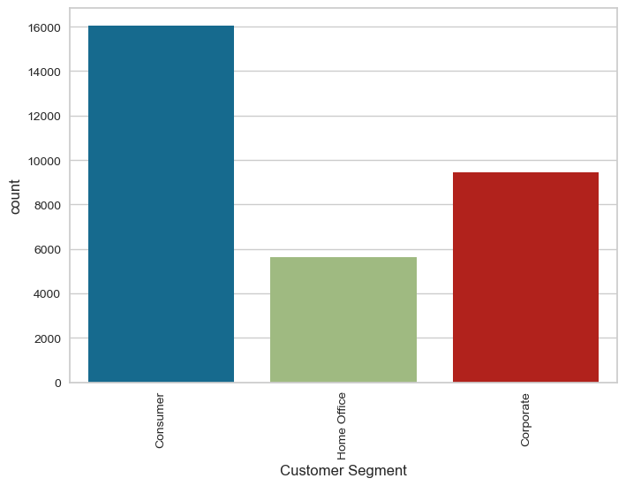
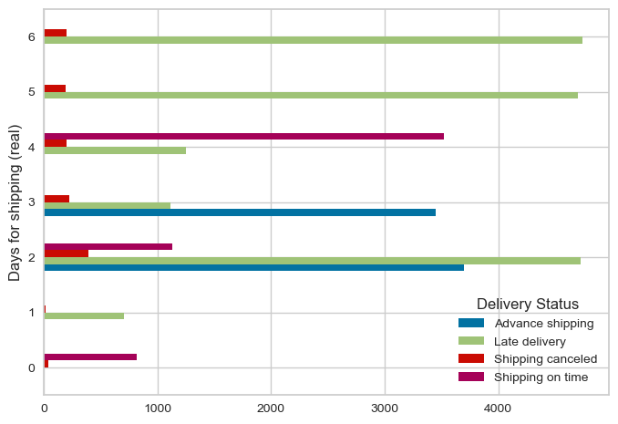
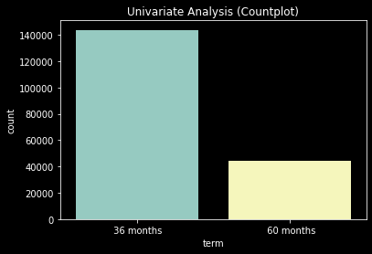
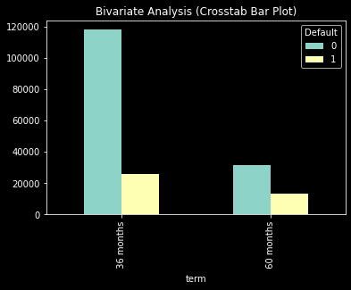
Significance: The distribution of segment is more in Consumer then corporate and home office.The probability of late delivery is comparatively higher on 2 , 5 and 6 day .
Univariate followed by Bivariate Analysis
P
H
A
S
E
2

Slide 13
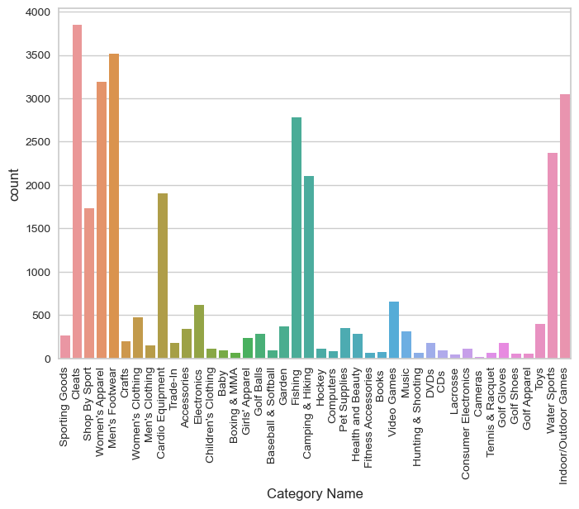
CATEGORY WISE - DISTRIBUTION

Slide 14
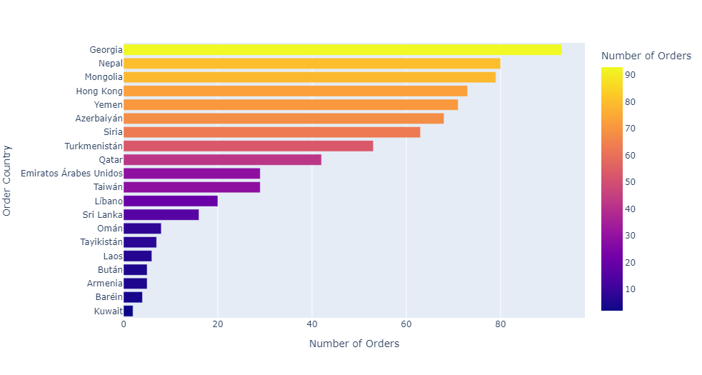
INFERENCES
Country-wise distribution of orders and Georgia has maximum orders followed by Nepal,mongolia,hong kong etc.

Slide 15
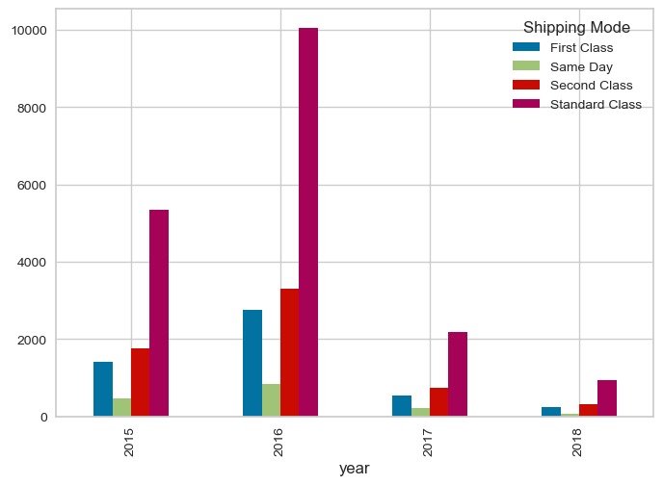
Univariate followed by Bivariate Analysis
P
H
A
S
E
2
Inferences: year
Business Understanding:
Standard class indicates higher value of sales in all the years.
On the other hand, same-day delivery sales are decreasing
and were minimized in 2018 due to late delivery.
Bivariate Analysis:
This is properly indicates that sales is decreasing year wise
because of the late delivery issue which cause in general
concern for the company.

Slide 16
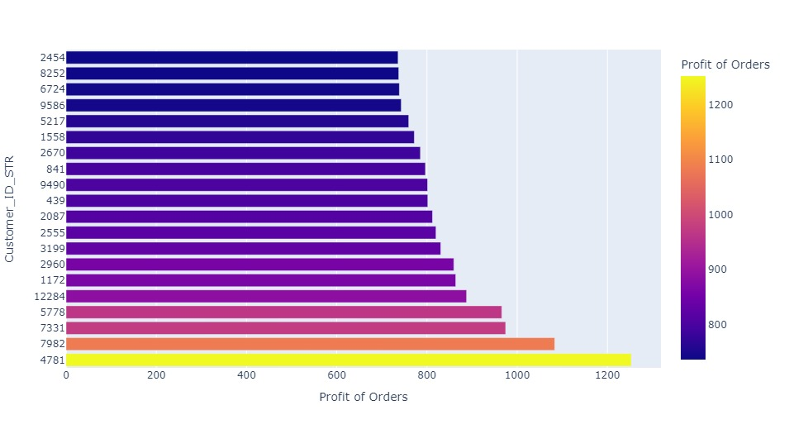
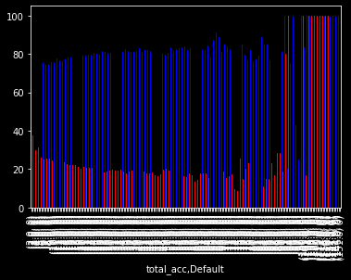
Univariate followed by Bivariate Analysis
P
H
A
S
E
2
Inferences: Profit of Orders
From the plot, we can get the inference of total profit of orders by each customer_ID_STR and it shows that ID 4781 shows maximum profit and ID 2454 shows the minimum profit.
Statistical Tests:
By doing Two Sample T Test and ANOVA: ‘Profit of Orders' is an important feature.

Slide 17
These are the general methods used for Treating missing values but we haven’t used any right now.
P
H
A
S
E
3
Simple Imputation
KNN Imputer
It is used for handling missing data in a dataset by imputing (replacing) missing values with a specified strategy(strategy such as mean,median,mode).
The k-Nearest Neighbors (KNN) imputer is an imputation technique that leverages the information from the k nearest neighbors of a data point to estimate and fill in missing values.

Slide 18
Statistical Analysis
P
H
A
S
E
4
Conducted Chi-square test at 5% Significance level (p-value).
The predators that have p-value > 5 are not significant for the prediction of target statistically.
Whereas, the number of predators below 0.5 p-value are significant for the prediction of target statistically.

Slide 19
Data Pre-Processing (Scaling & Encoding)
P
H
A
S
E
5
Splitting the data into train and test sets for validation
Doing frequency and label encoding on all the categorical features and standardizing the numerical columns for pre-processing.
Our target column is balanced as there is a proper distribution of the classes in a given dataset.
Since Statistical models only generate slope and not intercepts so we are adding a constant column so that the model can generate intercepts.

Slide 20
Inferences from 1st model
TRAIN | TEST
Accuracy = 63% | Accuracy = 62%
Precision = 67% | Precision = 66%
Recall = 64% | Recall = 63%
F1_Score = 0.66 | F1_Score = 0.64
Model is performing average as of now……..

Slide 21
Phase -2 Feature Engineering & Model Building
Group 2
Presented By

Slide 22
04
Feature Engineering Extracting new features from existing features
Features | Name of Features | Data Dictionary of new features
Feature 1 | Year | Extracting year from the independent name order date (DateOrders)
Feature 2 | Month | Extracting Month from the independent name order date (DateOrders)
Feature 3 | Day | Extracting Day from the independent name order date (DateOrders)
Feature 4 | Time | Extracting Time from the independent name order date (DateOrders)
Feature 5 | Customer_ID_STR | Created by separating out the special character from column customer_ID

Slide 23
Scaling & Encoding
By applying standard scaling, we can transform the features to a similar scale and range. This can help the model to learn from all the features equally, and prevent the larger-scale features from dominating the model. This can lead to better model performance and generalization.
P
R
E
P
R
O
C
E
S
S
I
N
G
Encoding the categorical features: Label and Frequency encoding can be useful because many of the features are categorical variables that have no inherent order or numerical meaning.

Slide 24
Logistic regression is a binary classification method that uses a logistic function to estimate the probability of a binary outcome variable based on one or more predictor variables
Random Forest Classifier is a type of ensemble learning method in which multiple decision trees are constructed and combined to improve the accuracy and robustness of the classification model. Each tree in the random forest is trained on a randomly selected subset of features and a randomly sampled subset of the training data.
M
O
D
E
L
S
E
L
E
C
T
I
O
N
Decision tree classifier is a type of supervised machine learning algorithm that performs classification by recursively splitting the dataset into smaller and smaller subsets based on the feature values. The algorithm creates a tree-like model of decisions and their possible consequences.
Bagging Classifier is an ensemble machine learning algorithm that combines the predictions of multiple base classifiers to improve overall performance and robustness.

Slide 25
Naive Bayes is a type of probabilistic machine learning algorithm that is commonly used for classification tasks. It is based on Bayes' theorem, which describes the probability of an event based on prior knowledge of related events.
M
O
D
E
L
S
E
L
E
C
T
I
O
N
Gradient Boosting is a machine learning algorithm that is commonly used for regression and classification tasks. It is an ensemble learning method that combines several weak learners (e.g., decision trees, linear models) to create a strong model.

Slide 26

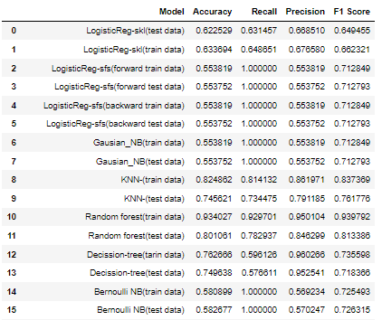
Model Performance Matrix
M
O
D
E
L
E
V
A
L
U
A
T
I
O
N

Slide 27
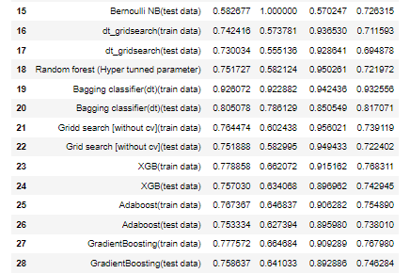

Slide 28
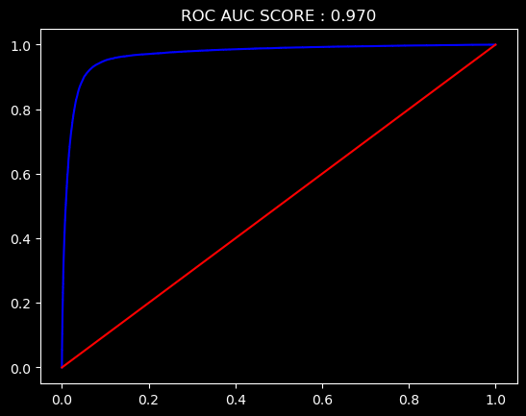
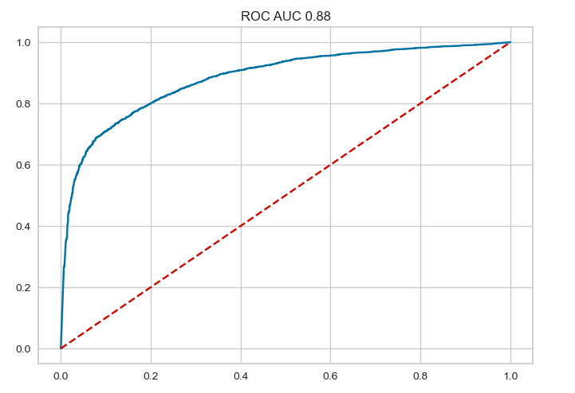
Final Model Metrics
M
O
D
E
L
D
E
P
L
O
Y
M
E
N
T
RANDOM FOREST MODEL | MODEL DEPLOYMENT OF YEAR- 2013
 | Train Metrics | Test Metrics
Confusion Matrix | [[10432 673 [969 12815]] | [[2287 490 [748 2698]]
Accuracy | 0.934 | 0.801
Precision | 0.950 | 0.846
Recall | 0.929 | 0.782
F1 Score | 0.939 | 0.813
ROC-AUC Curve | 0.931 | 0.886

Slide 29
We have applied Hyper-parameter tunning for DT, RF Classifier.
M
O
D
E
L
T
U
N
I
N
G
For Decision Tree:
Max Depth : [5,10]
Criterion: ['Gini', 'Entropy]
For Random Forest:
Max Depth : [10,15]
Criterion: ['Gini', 'Entropy]
N_Estimators : [50,100,200]
Out of all the models, Random-Forest gives the best results for our data.

Slide 30
Based on the performance metrics you provided, it appears that the Random Forest Classifier is performing very well on both the training and test data. The high precision, recall, and F1 scores on the training data suggest that the model is able to accurately identify both positive and negative cases with high confidence. The similarly high precision, recall, and F1 scores on the test data suggest that the model is also able to generalize well to new data. The F1 score, which is a harmonic mean of precision and recall, is a good measure of the overall performance of the model. The F1 score of 93% for the training data and 81% for the test data indicates that the model is performing very well overall, with high accuracy and relatively low error rates.
C
O
N
C
L
U
S
I
O
N

Slide 31
05
References
LINKS AND REFERENCES
https://www.kaggle.com/datasets/dadsrichboyvlogs/supply-chain-management-asia.
https://olympus.mygreatlearning.com/courses/89611/files/7373481

Slide 32
Thank You!
Group 2
Presented By

